Slide 1


AI-DRIVEN PROTEIN STRUCTURE PREDICTION USING GRAPH NEURAL NETWORKS(GNNs)
PAAVAI COLLEGE OF ENGINEERING
Approved By AICTE Government of India | Afflicted to Anna University, Chennai
(Department of Computer Science and Engineering)
PRESENTED BY
MANIKANDAN N(622021243035)
LOHITH V U(622021243032)
JEEVA B(622021243024)
GUIDED BY
MR. ASHOK KUMAR.,M.Tech .,
ASSISTANT PROFESSOR,
DEPARTMENT OF ARTIFICIAL
INTELLIGENCE & DATA SCIENCE

Slide 2
ABSTRACT
This research proposes a Graph Neural Network (GNN)-based method for predicting protein structures directly from amino acid sequences, bypassing the need for Multiple Sequence Alignments (MSA) and evolutionary data.
The model represents proteins as molecular graphs, where nodes are amino acids and edges capture chemical and spatial interactions. Using Graph Convolutional Networks (GCN) and Graph Attention Networks (GAT), the model predicts 3D atomic coordinates by learning residue-residue relationships.
The approach is lightweight, scalable, and computationally efficient, enabling real-time predictions without requiring extensive computational resources. This GNN method offers an alternative to traditional Transformer-based models, balancing accuracy and efficiency.

Slide 3
LITERATURE REVIEW
combined Transformers and GNNs to model sequence and structural dependencies, achieving high accuracy in structure-function prediction tasks.
used GNNs to capture 3D folding patterns. Their model improved folding prediction especially for proteins without template structures.
applied GNNs for modeling protein-ligand and protein-protein interactions. Their method outperformed classical ML models in binding site prediction.

Slide 4
PREDICTION PIPELINE
Data Preparation
Graph Construction
GNN Training
Structure Prediction & Refinement
Visualization and Evaluation

Slide 5
PROBLEM DEFINITION
Limitations in current protein structure prediction methods
Models like MSA have challenges in accuracy, particularly for novel protein folds.
Computational costs associated with traditional methods scale poorly for large proteins.
Justification for using GNNs
Ability to model proteins as graphs.
Capturing complex relationships between amino acids.
Potential to learn structural patterns from data.
Issues in the proposed method
Computational Complexity in Large Proteins.
Data Sparsity and Quality Issues.

Slide 6
PROPOSED SYSTEM
Graph construction: Nodes represent amino acids, edges represent spatial relationships
Training data: PDB database (specify version, size).
Loss function: Root Mean Squared Deviation (RMSD), Global Distance Test - Total Score (GDT_TS).

Slide 7
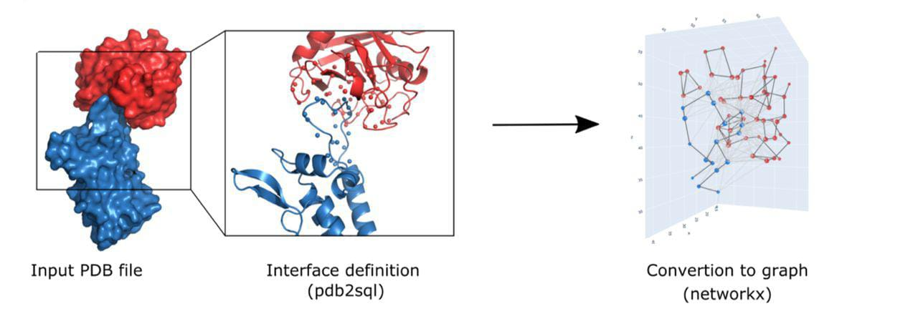
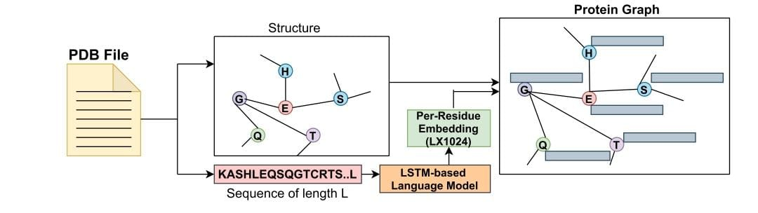
SYSTEM ARCHITECTURE

Slide 8
ALGORITHMS
Step 1 : Data preparation
Step 2 : Graph construction
Step 3 : Message passing in GNN
Step 4 : Stucture prediction
Step 5 : Refinement and energy minimization
Step 6 : Evaluation and validation

Slide 9
PERFORMANCE METRICS
Structural accuracy metrics
Measures how well the predicted structure aligns with the true structure based on different distance threshold
Computational efficiency metrics
Measures how fast the model predicts structure
Qualitative evaluation metrics
Ensures predicted structure obey physical and chemical constraints

Slide 10
MODULES
Data preprocessing & Graph construction
Graph Neural Network (GNN) model development
Training & optimization modules
Structure prediction & refinement
Evaluation & validation
Deployment & application module

Slide 11
REFERENENCES
A. Jain, “Machine Learning Techniques For Medical Diagnosis: A Review,” Int. Conf. Sci. Manag., pp. 2449–2459, 2015
Y. Qiu and G. W. Wei, “Artificial intelligence-aided protein engineering: from topological data analysis to deep protein language models,” Brief. Bioinform., vol. 24, no. 5, pp. 1–13, 2023, doi: 10.1093/bib/bbad289.
S. Choudhuri et al., “Recent Advancements in Computational Drug Design Algorithms through Machine Learning and Optimization,” Kinases and Phosphatases, vol. 1, no. 2, pp. 117 140, 2023, doi: 10.3390/kinasesphosphatases1020008.
D. Shiny Irene, V. Surya, D. Kavitha, R. Shankar, and S. John Justin Thangaraj, “An Intellectual Methodology for Secure Health Record Mining and Risk Forecasting Using Clustering and Graph-Based Classification,” J. Circuits, Syst. Comput., vol. 30, no. 8, pp. 1–19, 2021, doi: 10.1142/S0218126621501358.
Ramakrishna, M.T.; Venkatesan, V.K.; Izonin, I.; Havryliuk, M.; Bhat, C.R. Homogeneous Adaboost Ensemble Machine Learning Algorithms with Reduced Entropy on Balanced Data. Entropy 2023, 25, 245. https://doi.org/10.3390/e25020245

